Slide 1

Alepo 5G – Network Functions
Presented to CASA systems | DD - MMM - YYYY

Slide 2
AGENDA

Slide 3
Agenda
Difference between 4G and 5G Architecture
Overview of 5G Offering
Solution Overview
Solution Components
Network Functions – AUSF
Network Functions - UDM
Network Functions - HSS
Network Functions - UDR
Network Functions – PCF+PCRF
Network Functions – SDM

Slide 4
Difference between and 4G and 5G Architecture

Slide 5
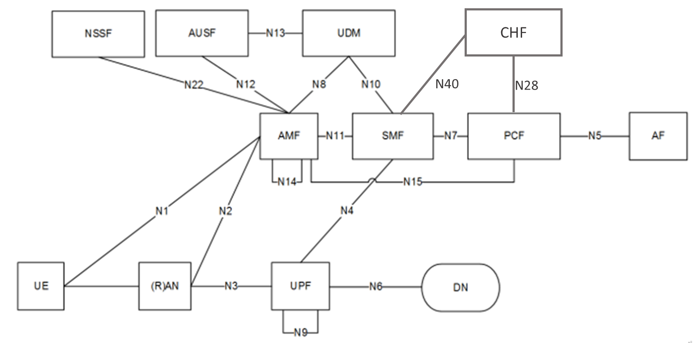


4G & 5G Architecture
4G EPC Core
5GC
S6a
HSS
MME
PCRF
S11
Gx
Sd
S1-MME
eNB
S1-U
SGW
S5/S8
PGW
SGi
TDF
SGi
PDN
HTTP/2 adopted as the application layer protocol for the service based interfaces
TCP adopted as the transport layer protocol
REST-style service design
JSON adopted as the serialization protocol;

Slide 6
Overview of 5G Offering

Slide 7
Alepo's 4G+5G Converged Core solution includes following core network functions:
Authentication Function (AUSF)
  Use of 5G-AKA method to perform SIM authentication.
Home Subscriber Server (HSS) + Unified Data Management (UDM)
  Generates 4G (EPS-AKA) and 5G (5G-AKA) authentication vectors
  Performs 4G and 5G service authorization using subscription data
Policy and Charging Rule Function (PCRF) + Policy Control Function (PCF)
  Enables a converged policy control function for 4G and 5G networks
  Support for Gx & Rx interfaces
  Policy Authorization support
Unified Data Repository
  A highly scalable common database for EPC and 5GC subscriptions
  Holds SIM identities
  Holds subscriber profiles for 4G and 5G subscriptions
  Store subscriber related information for policy data

Slide 8
Solution Overview

Slide 9
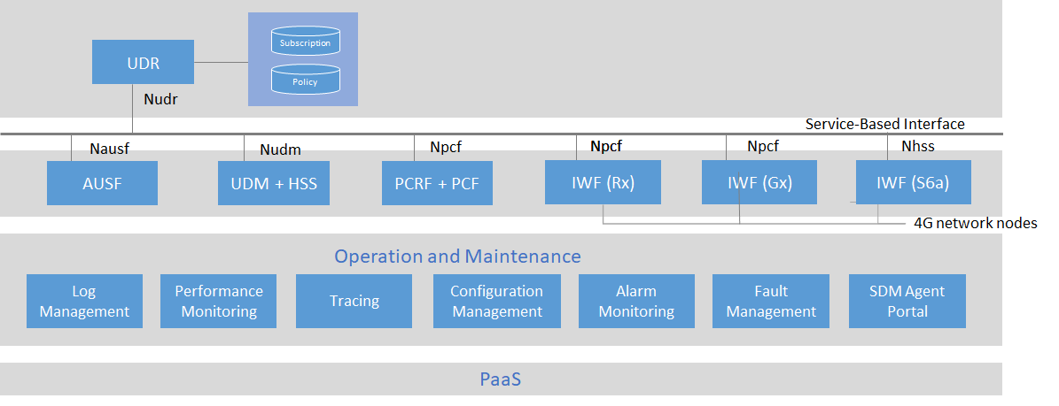
Functional Architecture

Slide 10
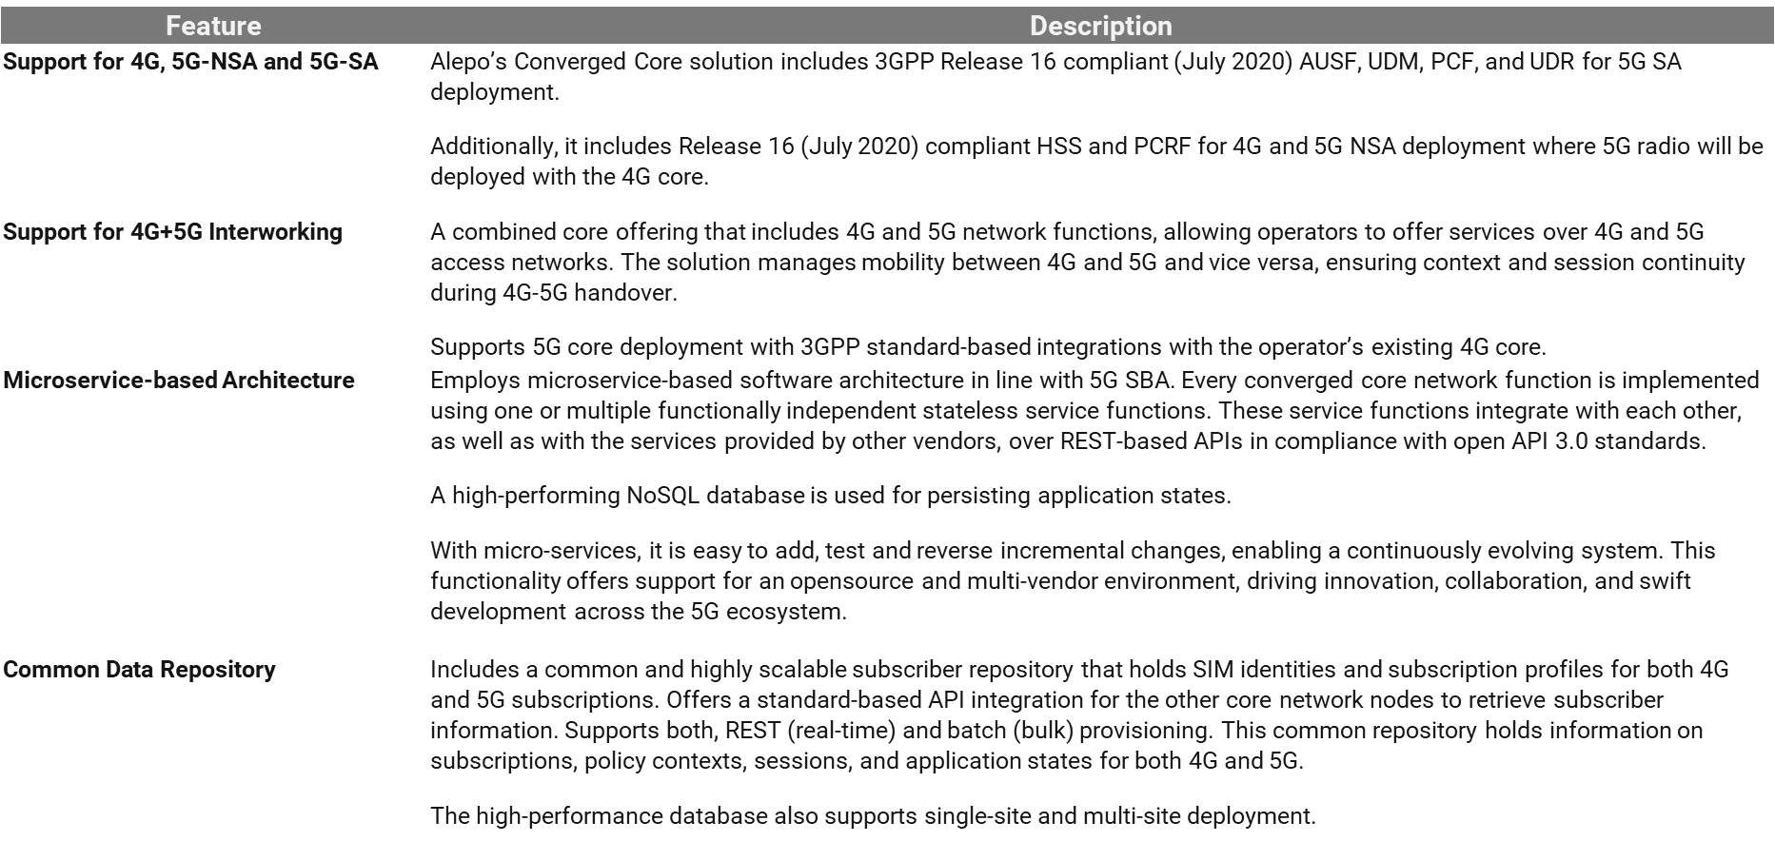
Feature Highlights

Slide 11
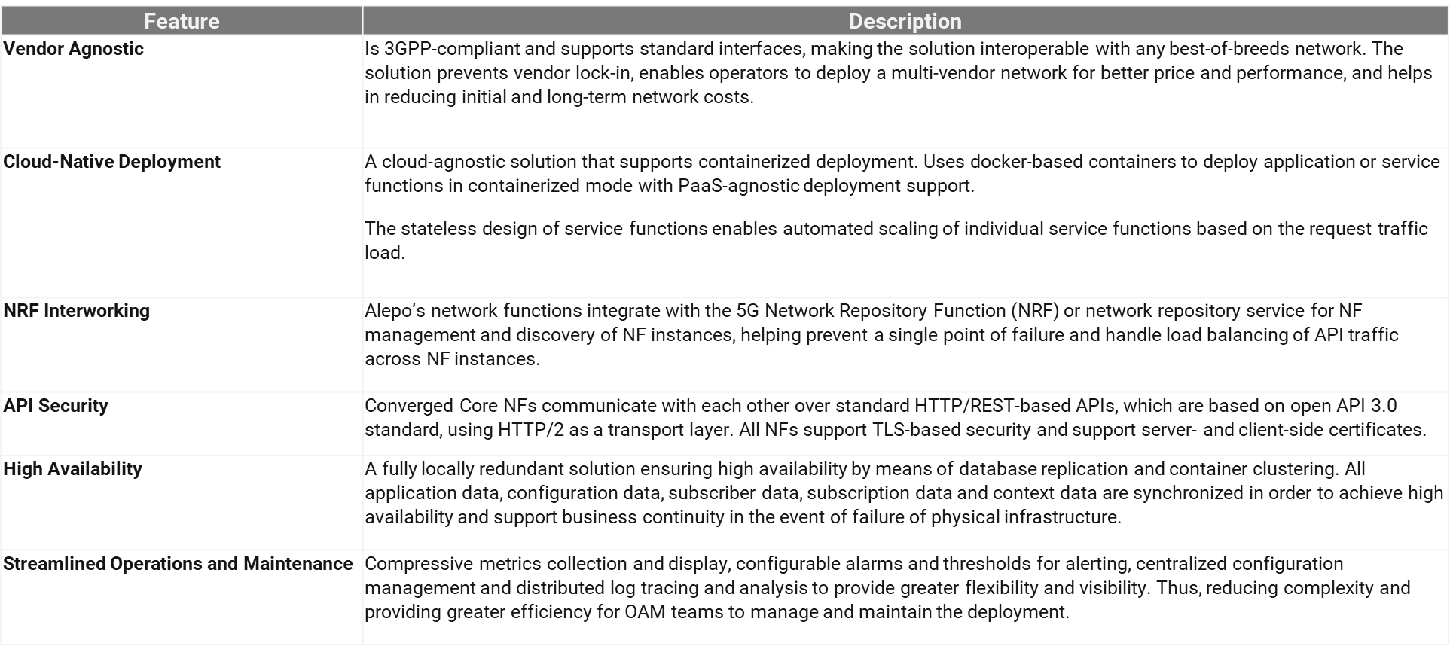

Slide 12
Solution Component Overview

Slide 13
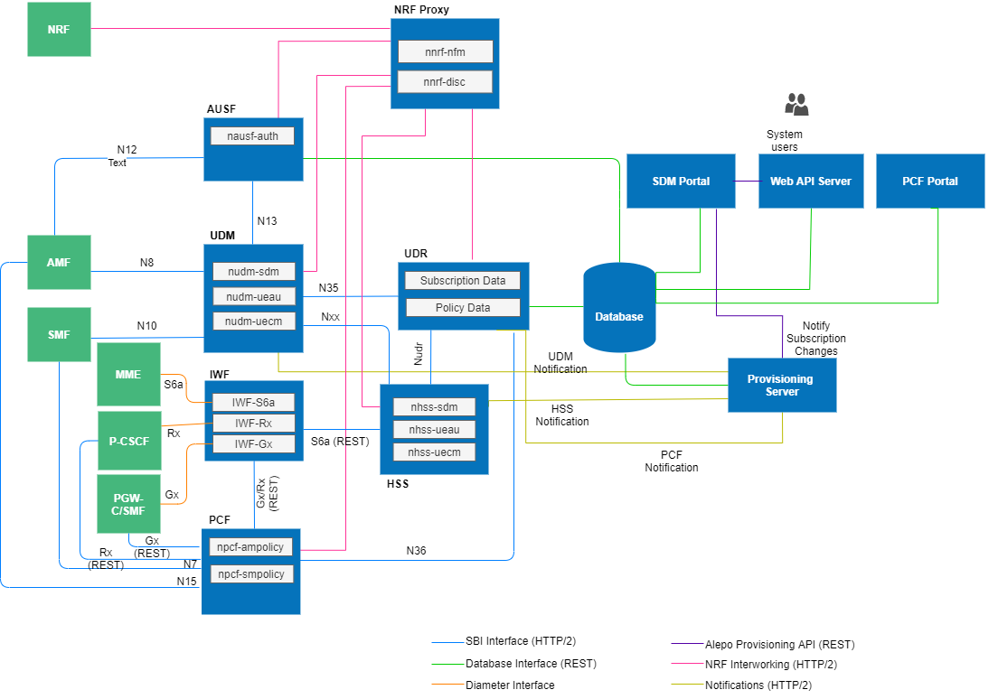
Solution Components

Slide 14
Network Function - UDR

Slide 15
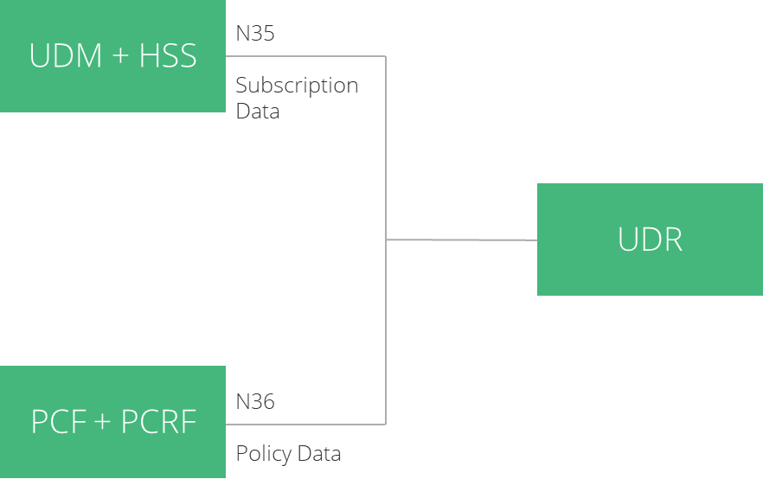
Alepo UDR
Alepo’s UDR function is fully compliant with TS 29.504 , TS 29.505. It is responsible for the following major functionalities:
Serves as the data repository solution compliant with Release 16 (July 2020) 3GPP TS 29.504, TS 29.505
Storage and retrieval of 4G+5G subscriptions and policy data
Subscription for notifications of subscriber data changes
High-performance and scalable 4G+5G subscriber repository
Support for single- and multi-site deployment
Web-based admin portal for managing subscriptions, SIM identities, service configurations and policy data for subscribers
REST (real-time) or batch (bulk) SIM provisioning
Support for roaming use cases
Support for V2X subscriptions
Integrates with third-party UDM and PCF over standard 3GPP interfaces

Slide 16
UDR Services
Using the Nudr interface, the UDR communicates with UDM and PCF. The UDR supports the following services:
Nudr_DataRepository Service
This service allows consumer NFs to retrieve, create, modify, and delete data stored in the UDR. It also allows the NF service consumers to subscribe and unsubscribe to data change notifications.
The following service operations are used for the Nudr_DataRepository service:
Query
Create
Delete
Update
Subscribe
Unsubscribe
Notify

Slide 17
UDR Configuration
These are the steps to upgrade Installation or Configuration
Step-1: Make appropriate changes in override file
Step-2: Use the following command
Delete NF
Use the following command
# helm3 helm upgrade udr udr -f udr-override.yaml -n <namespace> # helm2 helm upgrade udr udr -f udr-override.yaml --namespace <namespace>
# helm3 helm del udr -n <namespace> # helm2 helm del --purge udr

Slide 18
Network Function - UDM

Slide 19
Alepo UDM
Alepo’s Unified Data Management (UDM) function is fully compliant with the TS 29.503 Release 16.
The UDM is responsible for the following major activities:
Support for 3GPP S6a with MME and Nudm interface with AMF and SMF based on 3GPP TS 29.272 R16 and TS 29.503 R16
Supports EPS-AKA, 5G-AKA authentication methods
Manages user identities (storage and management of SUPI/SUCI/IMSI/GPSI for each subscriber in the 4G+5G)
SUCI de-concealing (SUCI to SUPI conversion) using Profile A, Profile B, and null scheme method
Handles 4G authentication and service authorization using subscription data
Stores and manages AMF/MME and SMF contexts for UEs
Support for V2X subscription data and Dedicated Core
Support for PLMN-based authentication and authorization (including roaming use cases)
Supports inter-RAT, intra-RAT mobility
Enables service and session continuity by managing SMF/DNN contexts for ongoing sessions
Supports for Interworking Function (IWF) for interfacing with 4G network nodes
Subscriber information is stored in the UDR. The UDM function manages subscription data for access authorization, user registration, and data network profiles, which it retrieves from the UDR and sends to other network functions. Alepo UDM also supports integration with third-party UDR over standard Nudr interface

Slide 20
UDM Services
UDM Services
Alepo UDM supports the following services:
nudm_sdm service
Nudm_SubscriberDataManagement service is used by consumer NFs (AMF, SMF, SMSF) to retrieve/modify the subscription data that is relevant to the consumer NF from the UDM. It also used by consumer NFs to subscribe and unsubscribe from notifications of data changes.
The following service operations are used for the Nudm_SubscriberDataManagement service:
Get
Subscribe
Unsubscribe
Notification
Info
nudm_uecm service
Nudm_UEContextManagement service is used by consumer NFs (AMF, SMS, SMSF) to register or deregister at the UDM. It is also used to retrieve and update registration information.
The following service operations are used for the Nudm_UEContextManagement service:
Registration
Deregistration Notification

Slide 21
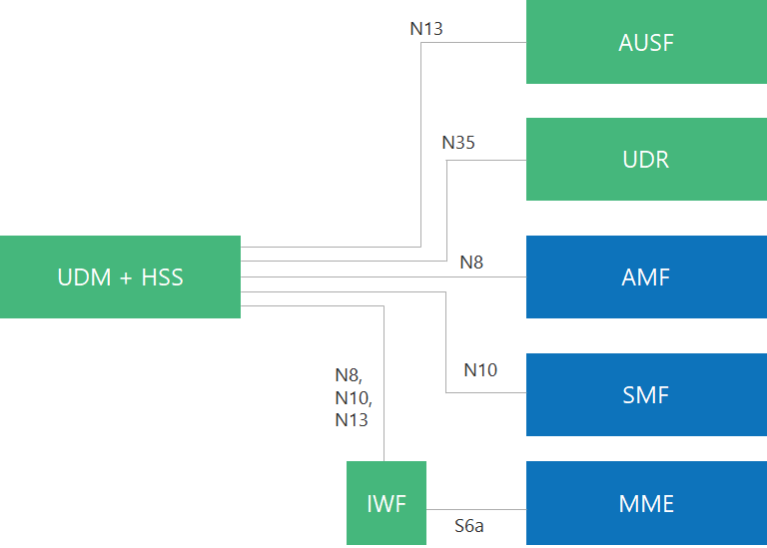
UDM Services
Deregistration Notification
Deregistration
Get
Update
nudm_ueau service
Nudm_UEAuthentication service is used by the AUSF to request UDM to select an authentication method, calculate fresh authentication vectors and provide it to AuSF. It is also used to convey the success or failure of authentication events to UDM.
The following service operations are used for the Nudm_UEAuthentication service:
Get
Result Confirmation

Slide 22
UDM – Upgrade Installation or Configuration
Step-1: Make appropriate changes in override file
Step-2: use the following command
Use the following commandto delete the NF:
# helm3 helm upgrade udm udm -f udm-override.yaml -n <namespace> # helm2 helm upgrade udm udm -f udm-override.yaml --namespace <namespace>
# helm3 helm del udm -n <namespace> # helm2 helm del --purge udm

Slide 23
Network Function - HSS

Slide 24
Alepo 4G HSS
Alepo HSS contains subscriber information, including service profiles, authentication ciphering, subscription state, and authorization. The streamlined architecture of LTE enables the storage of this information in a single node (UDM+HSS), which signals to the rest of the network to grant, restrict, or alter access.
Alepo HSS includes an integrated AuC function to perform authentication for access in the 4G network.
Major features:
3GPP compliant based on TS 29.272 R16
Authentication and registration management for 4G as well as 5G-NSA
Support for PLMN-based authentication and location updates (including roaming use cases)
Web-based portal for managing subscriptions, services, and SIM batches
Dedicated core network support
4G interworking to support inter-domain mobility
Integration with UDR and a common repository for subscription and context management
Integration with Interworking Function (IWF) for interfacing with MME
Nxx interface support for 4G-5G interworking
Support for PDU session continuity (N26 interworking support)

Slide 25
HSS Services
Alepo 4G HSS supports the following services
nhss_uecm service
Nhss_UEContextManagement service is used by consumer NFs (MME) to register or deregister at the HSS. It is also used to retrieve and update registration information.
The following service operations are used for the Nhss_UEContextManagement service:
Registration
Deregistration Notification
Deregistration
Get
Update
nhss_ueau service
Nhss_UEAuthentication service is used by the IWF to request HSS to calculate fresh authentication vectors and provide it to MME. It is also used to convey the success or failure of authentication events to MME.
The following service operations are used for the Nhss_UEAuthentication service:
Get

Slide 26
HSS – Upgrade Installation or Configuration
Step-1: Make appropriate changes in override file
Step-2: use the following command
# helm3 helm upgrade hss hss-iwf -f hss-override.yaml -n <namespace> # or helm upgrade iwf hss-iwf-f iwf-override.yaml -n <namespace> # or helm upgrade hss-iwf hss-iwf -f hss-iwf-override.yaml -n <namespace> # helm2 helm upgrade hss-iwf hss -f hss-override.yaml --namespace <namespace> # or helm upgrade hss-iwf iwf -f iwf-override.yaml --namespace <namespace> # or helm upgrade hss-iwf hss-iwf -f hss-iwf-override.yaml --namespace <namespace>
# helm3 helm upgrade hss hss-iwf -f hss-override.yaml -n <namespace> # or helm upgrade iwf hss-iwf-f iwf-override.yaml -n <namespace> # or helm upgrade hss-iwf hss-iwf -f hss-iwf-override.yaml -n <namespace> # helm2 helm upgrade hss-iwf hss -f hss-override.yaml --namespace <namespace> # or helm upgrade hss-iwf iwf -f iwf-override.yaml --namespace <namespace> # or helm upgrade hss-iwf hss-iwf -f hss-iwf-override.yaml --namespace <namespace>

Slide 27
HSS – Upgrade Installation or Configuration
Use the following command to delete NF
# helm3 helm del hss -n <namespace> # or helm del iwf -n <namespace> # or helm del hss-iwf -n <namespace> # helm2 helm del --purge hss # or helm del --purge iwf # or helm del --purge hss-iwf
# helm3 helm upgrade hss hss-iwf -f hss-override.yaml -n <namespace> # or helm upgrade iwf hss-iwf-f iwf-override.yaml -n <namespace> # or helm upgrade hss-iwf hss-iwf -f hss-iwf-override.yaml -n <namespace> # helm2 helm upgrade hss-iwf hss -f hss-override.yaml --namespace <namespace> # or helm upgrade hss-iwf iwf -f iwf-override.yaml --namespace <namespace> # or helm upgrade hss-iwf hss-iwf -f hss-iwf-override.yaml --namespace <namespace>

Slide 28
Network Function - AUSF

Slide 29
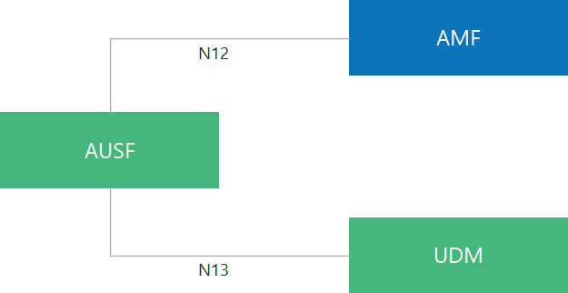
Alepo AUSF
Alepo’s Authentication Server Function (AUSF) is fully compliant with the TS 29.509 Release 16. It is responsible for carrying out UE authentication using the 5G-AKA authentication method.
Alepo’s AUSF receives authentication requests from AMF and requests the UDM to provide the HE authentication vectors. It generates 5G authentication vectors and sends them to the network via AMF. AUSF validates the signed response received from the network and determines if the UE authentication is successful. It also handles synchronization failures as a part of UE authentication request processing.
Key Features
3GPP TS 29.509 R16 (July 2020) compliant
Support for 5G authentication based on 5G-AKA
Manages authentication session states in the external centralized database
Handles authentication confirmation timeout
Support for re-synchronization failure management
Support routing based on SUCI and SUPI

Slide 30
Alepo AUSF Service
nausf_auth service
Nausf_UEAuthentication service permits authentication of the UE and to provide one or more master keys that are used by the AMF to derive subsequent keys
The authenticate service operation is used for the service
The AMF can initiate 5G-AKA authentication procedures

Slide 31
AUSF Configuration
These are the steps to upgrade Installation or Configuration
Step-1: Make appropriate changes in override file
Step-2: Use the following command
Delete NF
Use the following command
# helm3 helm upgrade ausf ausf -f ausf-override.yaml -n <namespace> # helm2 helm upgrade ausf ausf -f ausf-override.yaml --namespace <namespace>
# helm3 helm del ausf -n <namespace> # helm2 helm del --purge ausf

Slide 32
Network Function - PCF+PCRF

Slide 33
PCF+PCRF
PCF is a unified framework that provides rules for control plane functions and access to policy subscription information stored in the UDR database.
The converged policy control includes rules for data, voice, and application services for 4G+5G use cases.
Key Features:
Release 16 July 2020 compliant
Offers 3GPP Gx interface with PCEF based on 3GPP TS 23.203 R16 and TS 29.212 R16
Offers 3GPP Rx interface with IMS AF based on 3GPP TS 29.214 R16
Supports 4G, 5G-NSA, 5G-SA deployment
Support for access and mobility policies
Support for session management (SM) policies (with session and PCC rule)
Support for Policy Authorization
Support for usage and QoS monitoring
Seamless session continuity for inter-RAT handover
Support for Emergency DNN
High-performance flexible rule engine for policy evaluation
Support for change in policy for ongoing session
Supports interfaces with unified data repository over Nudr

Slide 34
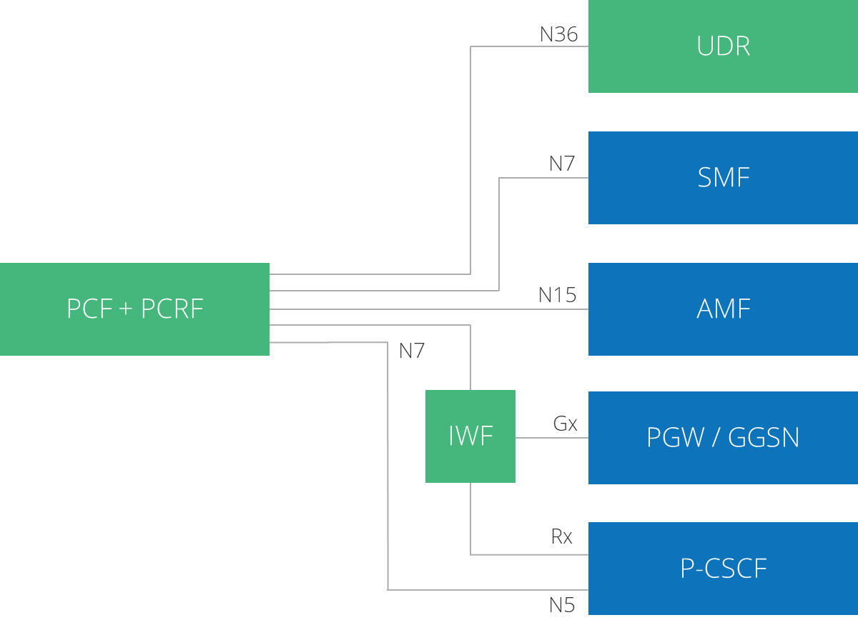
Alepo PCF Services
As per 3GPP TS 29.507 and 3GPP TS 29.512, PCF+PCRF supports the following services:
npcf_ampolicy service
Npcf_AMPolicyControl includes policies related to UE that have information regarding access, mobility, and PDU session selection are provided by PCF to AMF.
The following service operations are used:
Create
Update/Notify
Delete
Update

Slide 35
Alepo PCF Services
npcf_smpolicy service
SMF receives policy information for a PDU session using this Npcf_AMPolicyControl service. This information may contain:
Session-related parameters like charging information, QoS information, usage monitoring control information, volume or time-based thresholds, and more
CC rules-related information like rule identifier, service data flow detection, precedence, and more
The following service operations are used:
Create
Update/Notify
Delete
Update
npcf-policyauthorization Service
The Npcf_PolicyAuthorization service is used to authorize an AF request and to create policies as requested by the authorized AF for the PDU Session to which the AF session is bound.
If the PCF determines that an SM policy should be installed or updated due the AF request it can use the Npcf_SMPolicyControl service towards the SMF to install or modify the policies according to the AF request.
The following service operations are used:
Create
Update
Delete

Slide 36
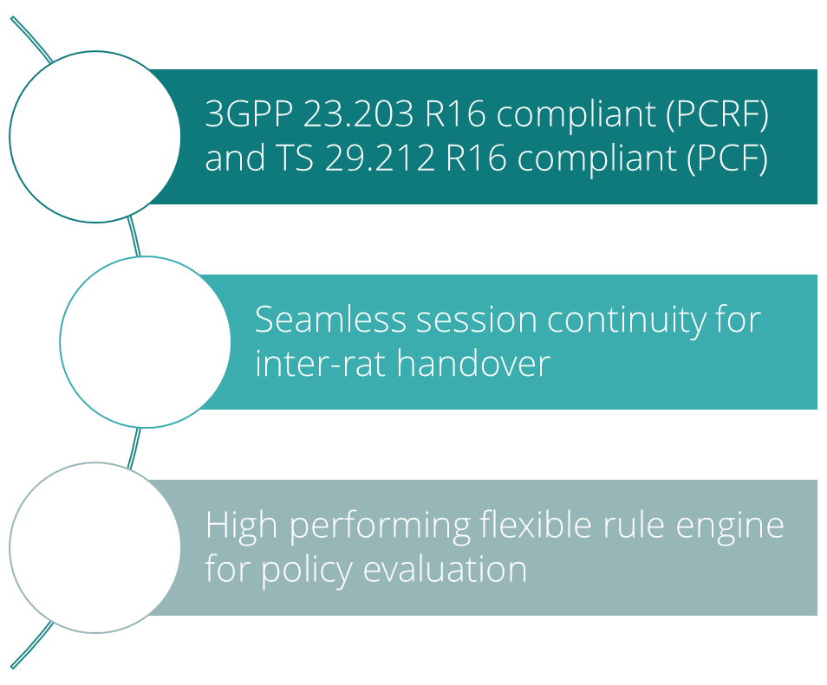
PCF Portal Overview
Policy Management – involves creation of policy profiles for
AM (access and mobility management) policy,
SM (session management) policy for PCC and session rules.
System Configurations - involves the creation of configurations
that may be needed as 'building blocks' while creating the policy
profiles or policy rules.
Subscriber Category - involves creation of category for
a subscriber segment. Each category includes one or multiple
policy rulesets and their resultant policy profiles.

Slide 37
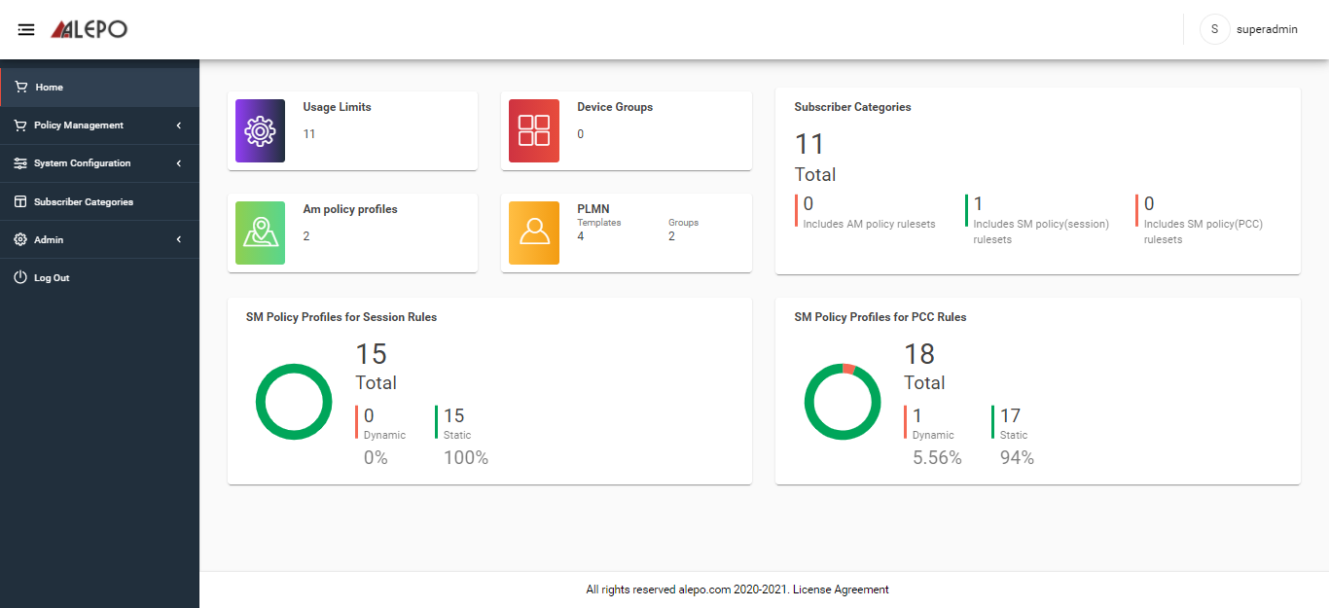
PCF Portal Overview
An easy-to-use GUI to create and manage AM and SM policy rules
Manage policy profiles for AM, SM (Session and PCC rules)
Manage system configurations for PLMN, devices, locations, usage limits

Slide 38
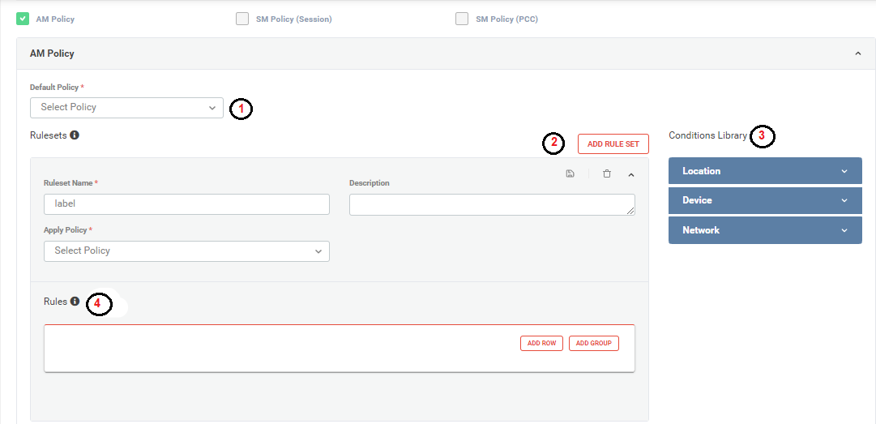
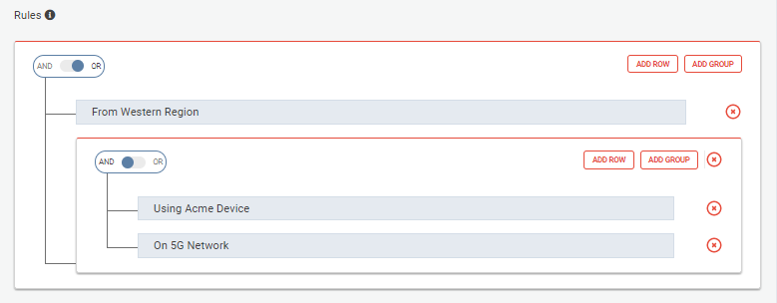
PCF Portal Overview
Precisely visualize sorting and prioritization logic for rulesets
Easy point-and-click policy configuration with -
  Support for default policy
  Manage AM, SM policy rulesets
  Rich library of ready-to-use policy conditions
  Drag-and-drop conditions to create policy rulesets

Slide 39
Policy Condition
Category | AM Policy | SM (Session) | SM(PCC)
Time-based |  | Day of the Week | Day of the Week
Location-based | PLMN | PLMN | PLMN
Device-based | Device ID | Device ID | Device ID
Network-based | Access Type RAT Type RFSP Index | Access Type RAT Type | Access Type RAT Type
Others |  | Group ID Application ID | Group ID Application ID

Slide 40
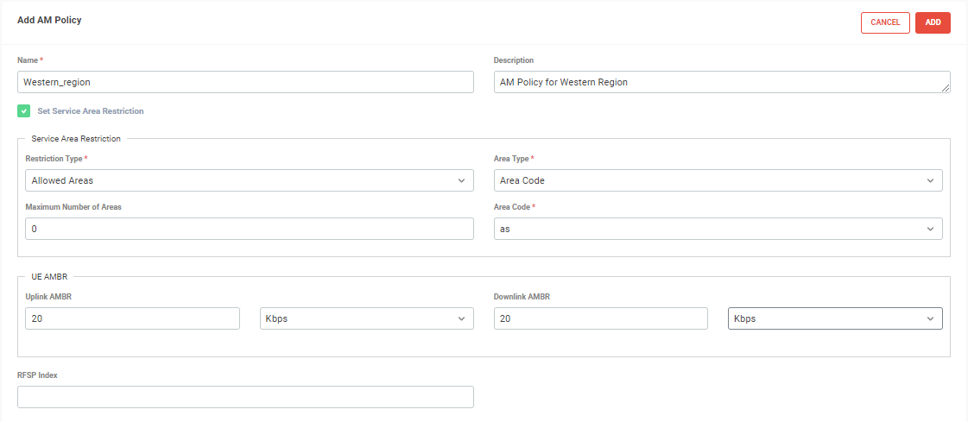
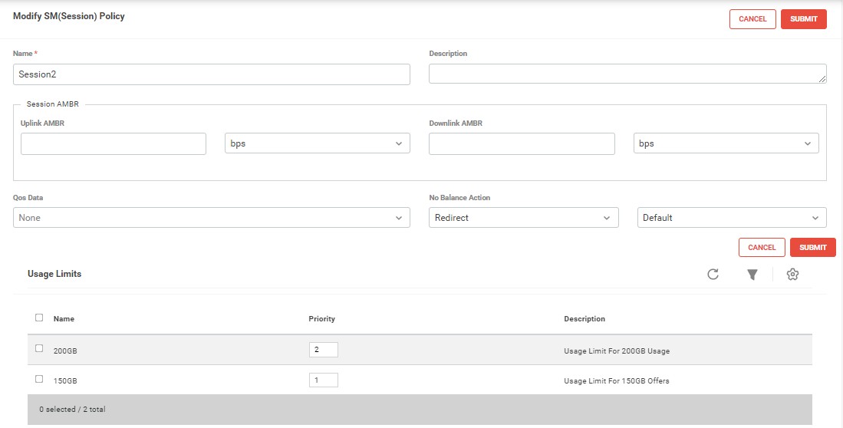
Policy Profile Management

Slide 41
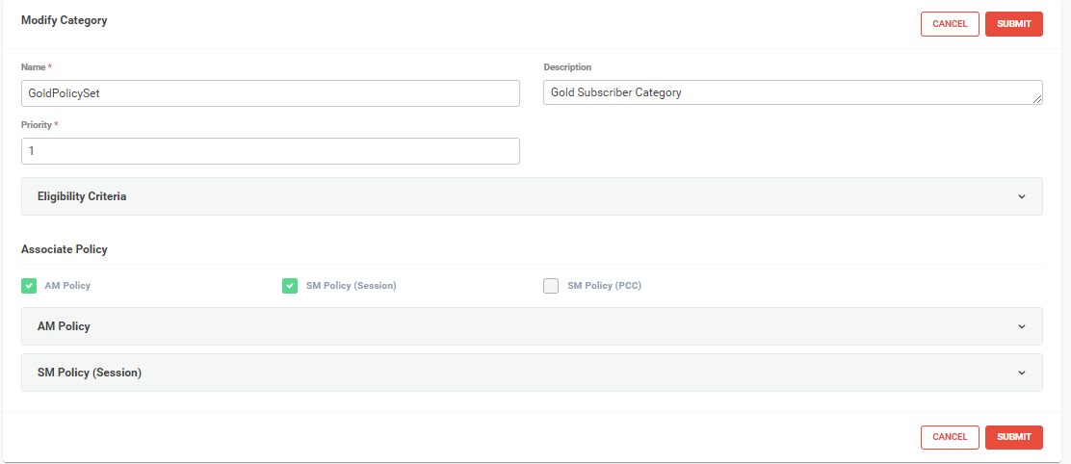
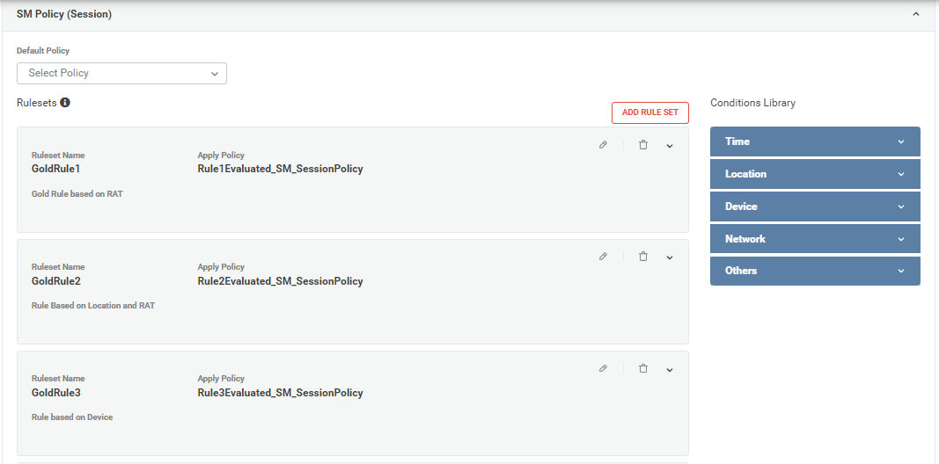
Subscriber Category Management
Eligibility Criteria to evaluate subscriber category
Associated policy rulesets

Slide 42
PCF+PCRF Configuration
These are the steps to upgrade Installation or Configuration
Step-1: Make appropriate changes in override file
Step-2: Use the following command
# helm3 helm upgrade pcf pcf-pcrf -f pcf-override.yaml -n <namespace> # or helm upgrade udrpcf pcf-pcrf -f udrpcf-override.yaml -n <namespace> # or helm upgrade iwfpcf pcf-pcrf -f iwfpcf-override.yaml -n <namespace> # or helm upgrade pcf-pcrf pcf-pcrf -f pcf-pcrf-override.yaml -n <namespace> # helm2 helm upgrade pcf-pcrf pcf -f pcf-override.yaml --namespace <namespace> # or helm upgrade pcf-pcrf udrpcf -f udrpcf-override.yaml --namespace <namespace> # or helm upgrade pcf-pcrf iwfpcf -f iwfpcf-override.yaml --namespace <namespace> # or helm upgrade pcf-pcrf pcf-pcrf -f hss-iwf-override.yaml --namespace <namespace>

Slide 43
PCF+PCRF Configuration
Delete NF
Use the following command
# helm3 helm del pcf-n <namespace> # or helm del udrpcf-n <namespace> # or helm del iwfpcf -n <namespace> # or helm del pcf-pcrf -n <namespace> # helm2 helm del --purge pcf # or helm del --purge udrpcf # or helm del --purge iwfpcf # or helm del --purge pcf-pcrf

Slide 44
Network Function - SDM

Slide 45
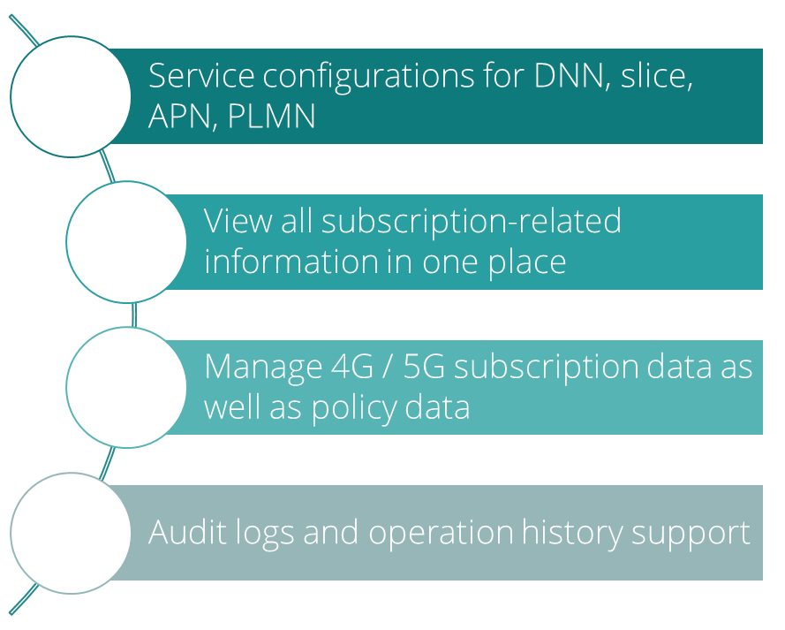
SDM Portal Overview
Provides an easy-to-use GUI system to manage service configurations and subscriber profiles
Allows importing and managing SIM batches
Stores SIM information in an encrypted format
Allows system users to carry out troubleshooting for subscription-related issues
Maintains privacy and security of the subscription data with role-based access
Major Feature:
SIM Batch Management – involves importing and managing SIM batches
Service Level Configurations – involves configurations for subscription and policy data
Subscription Management – involves viewing and managing the 4G and 5G subscription and policy data for a subscription profile

Slide 46
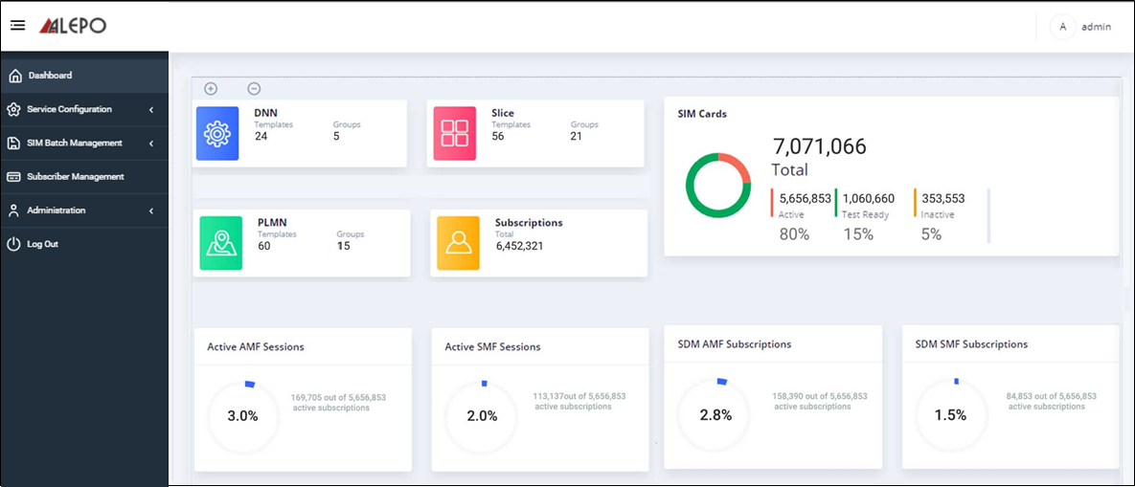
SDM Portal Homepage

Slide 47
SDM Portal Major Component Overview
SDM portal - The web application for Subscriber Data Management. It contains the the microservices SDM frontend and SDM backend.
  SDM Frontend: A microservice supporting the web portal
  SDM Backend: A microservice that interfaces with the database for subscriptions, configurations, and policy data management. It also interfaces with the provisioning server to send notifications to UDM, HSS and PCF.
SIM batch processor - A microservice that uploads and processes the bulk import of SIM batches.
Web API Servers: It includes:
  ContextManagement - API server for operator specific context management data
Provisioning Server - De-normalizes PLMN data of the subscriber and send notification to UDM and HSS on changes in subscriber data

Slide 48
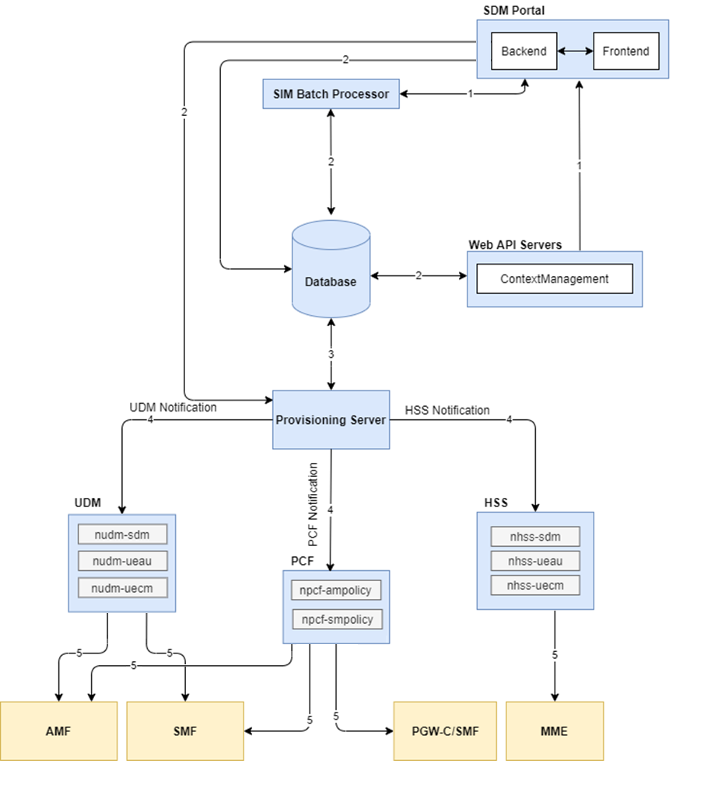
SDM Portal Call Flow
SIM batches are imported from the GUI using SIM batch processor.
The Web API server/SIM batch processor verifies the data or SIM batch and stores it in the database.
All the necessary subscription and configuration data are stored in the database using the SDM Backend microservice.
Any change in the subscriber/policy data is identified by the SDM portal backend and then notified to Provisioning Server.
If the subscriber/policy data is changed, the Provisioning Server sends a notification to the appropriate NF (e.g., UDM, HSS, PCF)
The change is then communicated by UDM/HSS/PCF with the appropriate consumer NF (e.g., AMF, SMF, MME, PGW-C)

Slide 49
SDM Configuration
These are the steps to upgrade Installation or Configuration
Step-1: Make appropriate changes in override file
Step-2: Use the following command
Delete NF
Use the following command
# helm3 helm upgrade sdm-portal sdm-portal -f sdm-portal-override.yaml -n <namespace> # helm2 helm upgrade sdm-portal sdm-portal -f sdm-portal-override.yaml --namespace <namespace>
# helm3 helm del sdm-portal -n <namespace> # helm2 helm del --purge sdm-portal

Slide 50
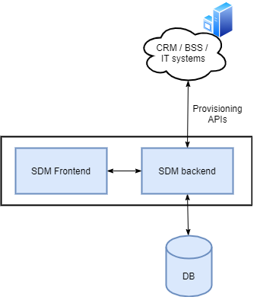
Provisioning APIs
Alepo 5G-Core solution provides rich library of APIs which are Open-API compliant to be used by external CRM/ IT systems for provisioning SIMs, subscriber management, subscription management and service configurations.
API Details

Slide 51
Show & Tell Session
SDM Portal Overview
PCF Portal Overview
Call flow
Fs

Slide 52
Corporate HQ
Austin, TX, USA
sales@alepo.com
Follow Us
www.alepo.com
AlepoUSA
@AlepoUSA
Company/Alepo

